Slide 1
Binary

Slide 2
Binary to Decimal Conversion
128 | 64 | 32 | 16 | 8 | 4 | 2 | 1 |  | In Decimal
0 | 0 | 0 | 0 | 1 | 0 | 1 | 1 | = | 11
0 | 0 | 1 | 0 | 1 | 1 | 0 | 1 | = | 45
1 | 0 | 1 | 1 | 0 | 0 | 0 | 1 | = | 177
1 | 1 | 1 | 0 | 0 | 1 | 0 | 0 | = | 228
0 + 0 + 0 + 0 + 8 + 0 + 2 + 1 = 11
0 + 0 + 32 + 0 + 8 + 4 + 0 + 1 = 45
128 + 0 + 32 + 16 + 0 + 0 + 0 + 1 = 177
128 + 64 + 32 + 0 + 0 + 4 + 0 + 0 = 228

Slide 3
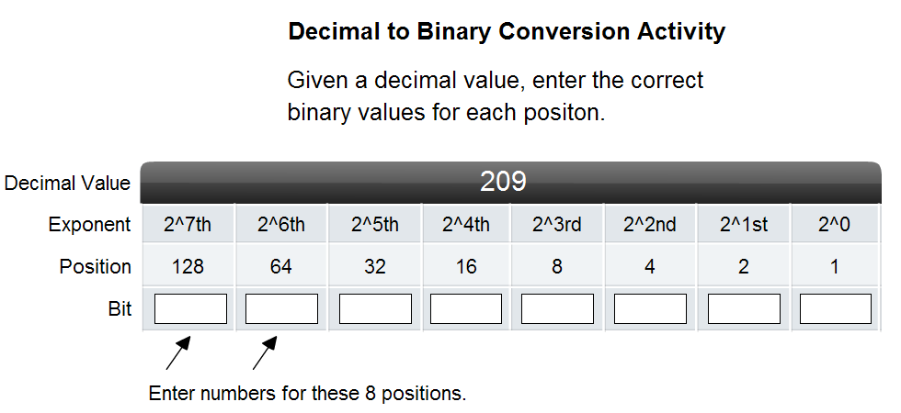
1
1
0
1
0
0
0
1
Is
209 >= 128
YES
209-128=
81
Is
81 >= 64
YES
81-64=
17
Is
17 >= 32
NO
Is
17 > =16
YES
17-16=
1
Is
1 >= 8
NO
Is
1 >= 4
NO
Is
1 >= 2
NO
Is
1> =1
YES
1-1=
0

Slide 4
Counting in Binary
128 | 64 | 32 | 16 | 8 | 4 | 2 | 1 |  | In Decimal
0 | 0 | 0 | 0 | 0 | 0 | 0 | 1 | = | 1
0 | 0 | 0 | 0 | 0 | 0 | 1 | 0 | = | 2
0 | 0 | 0 | 0 | 0 | 0 | 1 | 1 | = | 3
0 | 0 | 0 | 0 | 0 | 1 | 0 | 0 | = | 4
0 | 0 | 0 | 0 | 0 | 1 | 0 | 1 | = | 5
0 | 0 | 0 | 0 | 0 | 1 | 1 | 0 | = | 6
0 | 0 | 0 | 0 | 0 | 1 | 1 | 1 | = | 7
0 | 0 | 0 | 0 | 1 | 0 | 0 | 0 | = | 8
0 | 0 | 0 | 0 | 1 | 0 | 0 | 1 | = | 9
0 | 0 | 0 | 0 | 1 | 0 | 1 | 0 | = | 10
0 | 0 | 0 | 0 | 1 | 0 | 1 | 1 | = | 11
0 | 0 | 0 | 0 | 1 | 1 | 0 | 0 | = | 12
0 | 0 | 0 | 0 | 1 | 1 | 0 | 1 | = | 13
0 | 0 | 0 | 0 | 1 | 1 | 1 | 0 | = | 14
0 | 0 | 0 | 0 | 1 | 1 | 1 | 1 | = | 15
0 | 0 | 0 | 1 | 0 | 0 | 0 | 0 | = | 16
0 | 0 | 0 | 1 | 0 | 0 | 0 | 1 | = | 17
0 | 0 | 0 | 1 | 0 | 0 | 1 | 0 | = | 18
0 | 0 | 0 | 1 | 0 | 0 | 1 | 1 | = | 19
0 | 0 | 0 | 1 | 0 | 1 | 0 | 0 | = | 20
0 | 0 | 0 | 1 | 0 | 1 | 0 | 1 | = | 21
0 | 0 | 0 | 1 | 0 | 1 | 1 | 0 | = | 22
0 | 0 | 0 | 1 | 0 | 1 | 1 | 1 | = | 23
0 | 0 | 0 | 1 | 1 | 0 | 0 | 0 | = | 24
0 | 0 | 0 | 1 | 1 | 0 | 0 | 1 | = | 25
0 | 0 | 0 | 1 | 1 | 0 | 1 | 0 | = | 26
0 | 0 | 0 | 1 | 1 | 0 | 1 | 1 | = | 27

Slide 5
Counting in Binary
0
1
10
11
100
101
110
111
1000
1001
1010
1011
1100
1101
1110
1111
10000
10001
10010
10011
10100
10101
10110
10111
11000
11001
11010
11011

